Slide 1
Web Development: Dynamically Generated Content
Complex Data and Control Structures

Slide 2
Logical Operators
Operator | Name | Returns True if
|| | OR | Left or right is true
or | OR | Left or right is true
Xor | Xor | Left or right is true but not both
&& | AND | Left and right are true
And | AND | Left and right are true
! | Not | The single operand is not true

Slide 3
The if Statement
The if statement is a way of controlling executing of code
It has the following syntax
if (expression) {
//code to execute if expression evaluates to //true
}

Slide 4
The if Statement
<?php
$temp=27;
if ($temp<38){
echo “Today is a pleasant day!”;
}
?>

Slide 5
Using the else Clause with if Statement
When working with the if statement you can define alternative block code by adding the else clause
if (expression) {
//code to execute if the expression evaluates to true
}
else {
//code to execute in all other cases
}

Slide 6
Using the else Clause with if Statement
<?php
$temp=27;
if ($temp<38){
echo “Today is a pleasant day!”;
}
else {
echo “Today is not a pleasant day!”;
?>

Slide 7
Using the elseif Clause with if Statement
You can use an if…..elseif….else clause to test multiple expressions
if (expression) {
//code to execute if the expression evaluates to true
}
elseif (another expression) {
//code to execute if the previous expression failed and this //one evaluates to true
else {
//code to execute in all other cases
}

Slide 8
Using the elseif Clause with if Statement
<?php
$temp=21;
if ($temp==21){
echo “Temperature is room temperature”;
}
elseif ($temp>21 ){
echo “Today is a warm day!”;
}
else {
echo “Today is a cold day”;
}
?>

Slide 9
The switch statement
The switch statement is an alternative way of changing flow
A switch statement evaluates only one expression in a list of expressions
The switch statement has the following syntax:
switch (expression) {
case result1:
//execute this if expression results in results1
break;
default:
//execute this if no break statement has been encountered hitherto
}

Slide 10
The switch statement
<?php
$grade=‘A’;
switch(grade){
case ‘A’:
echo “That is excellent!”;
break;
case ‘B’:
echo “That is very good!”;
break;
default:
echo “Your grade is neither A, B, nor C”;
}

Slide 11
What are Arrays?
Arrays are special variables that enables you to store as many values as you want
Arrays are indexed with the first item on position 0, the second on 1 and so on

Slide 12
Creating Arrays
There are three types of arrays:
Numeric
Associative
Multidimensional

Slide 13
Numeric Arrays
A numeric array stores each array element with a numeric index

Slide 14
Numeric Arrays
Numeric arrays can be created as follows:
$student=array(“Theo”, “Jack”, “Sam”, “Ben”);
OR
$student[0]=“Theo”;
$student[1]=“Jack”;
$student[2]=“Sam”;
$student[3]=“Ben”;

Slide 15
Associative Arrays
An associative array, each ID key is associated with a value.
When storing data about specific named values, a numerical array is not always the best way to do it.
With associative arrays we can use the values as keys and assign values to them.

Slide 16
Associative Arrays
$employees = array(
array('name'=>'Sally Maxwell', 'position'=>‘Manager', 'yearEmployed'=>2001 ),
array('name'=>'George Smith', 'position'=>‘Engineer', 'yearEmployed'=>2006 ),
array('name'=>'Peter Roberts', 'position'=>'Clerk', 'yearEmployed'=>1992 ),
);

Slide 17
Multidimensional Arrays
Multidimensional array is an array consisting of other arrays
Look at the following arrays:
$multiple_five= array(5, 10, 15, 20, 25, 35);
$multiple_six= array(6, 12, 18, 24, 30);
They can be combined into one array named $numbers as follows:
$numbers= array (‘Fives’=> $multiple_five, ‘Sixes’ => $multiple_six);
To access for example the first element in the sub-array $multiple_six
$numbers[‘Sixes’][0]

Slide 18
Sorting Arrays
An array can be sorted by value discarding the original keys using the function sort()
$hndIM= array (‘Andy’, ‘Claire’, ‘Daniel’, ‘Lukas’, ‘Harry’, ‘Paul’, ‘Vivien’, ‘Harry’, ‘Graham’, ‘Glen’, ‘Sabrina’, ‘Peter’, ‘Alistair’);
sort($names);

Slide 19
Loops
Loop statements will enable you to perform repetitive tasks

Slide 20
The while Statement
The while statement has following syntax
while (expression) {
//execute code
}
The while statement will execute as long as the expression evaluates to true

Slide 21
The while Statement
<?php
$index=1;
while ($index<=12) {
echo “$index times 4 is”.($index*4).”<br/>”;
$index++;
}
?>

Slide 22
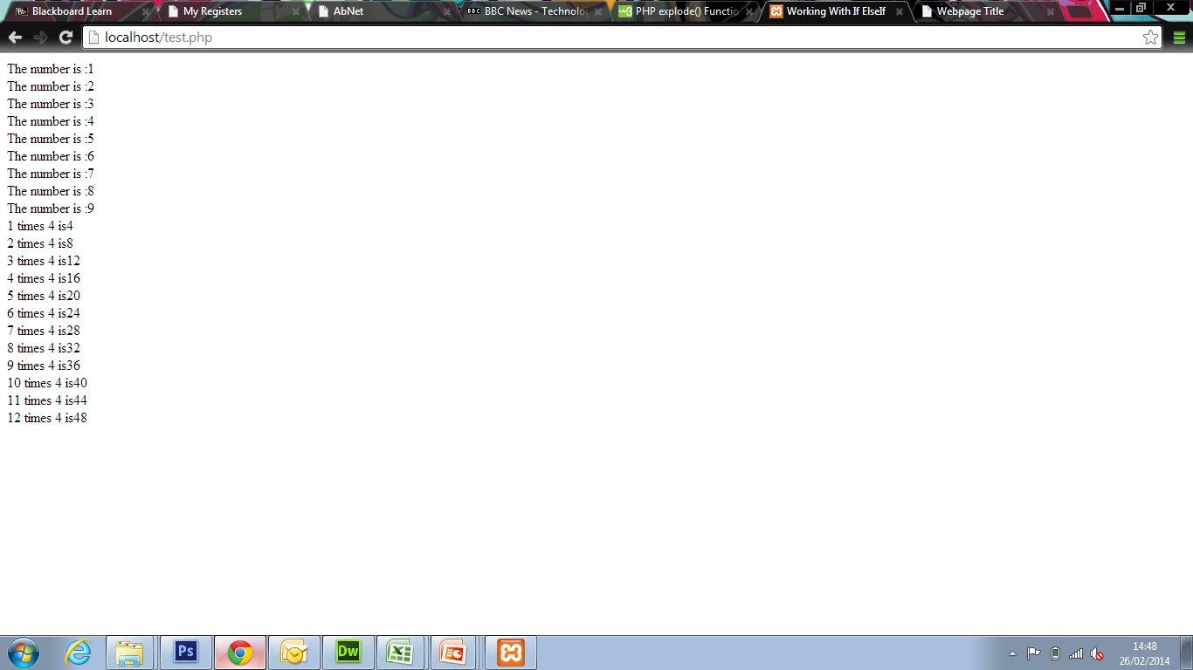

Slide 23
The do….while Statement
The do…while statement has the following syntax
do {
//execute code
} while (expression);
The do…while statement is similar to while statement but in do…while statement the code is executed before testing expression

Slide 24
The do….while Statement
<?php
$num=1;
do {
echo “The number is :” .$num.”<br/>”;
$num++;
} while ($num<10);
?>

Slide 26
The for Statement
The for statement has following syntax:
for (initialisation expression; test expression; modification expression) {
//execute code
}
Initialisation expression initialises a counter variable
Test expression is test condition for the loop
Modification expression increments the counter

Slide 27
The for Statement
<?php
for ($index=1; index<12; index++)
{
echo “$index times 4 is”.($index*4).”<br/>”;
}
?>

Slide 28
